Slide 1
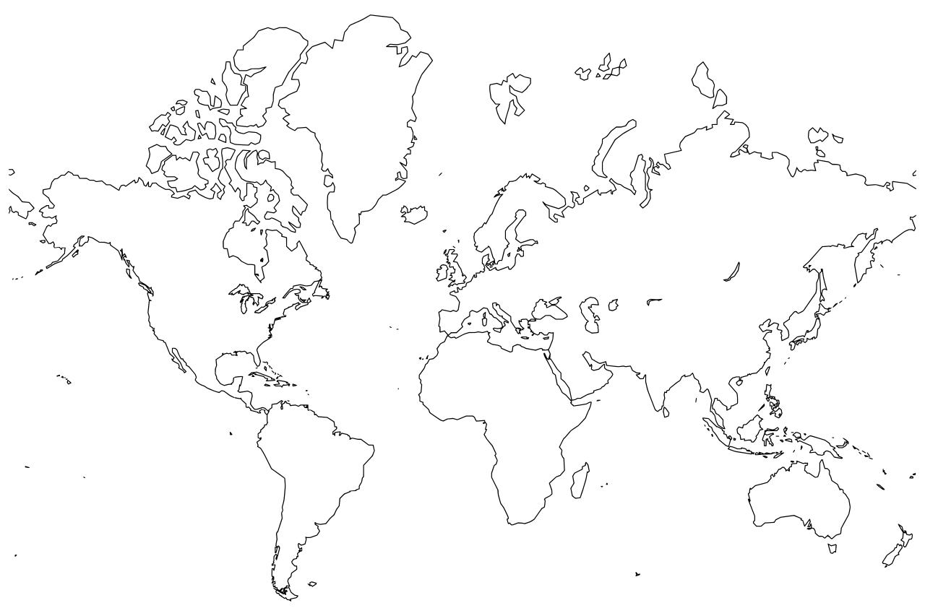

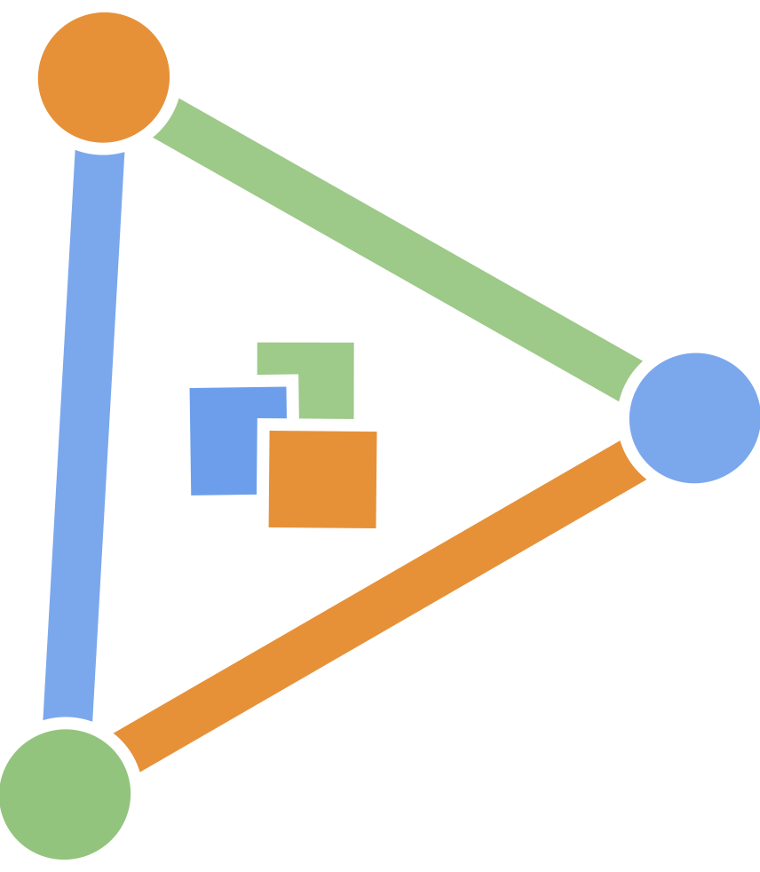



Establishing a community for supporting and fostering adoption of reproducible research using R
Adam H. Sparks
Emerson M. Del Ponte

Slide 2
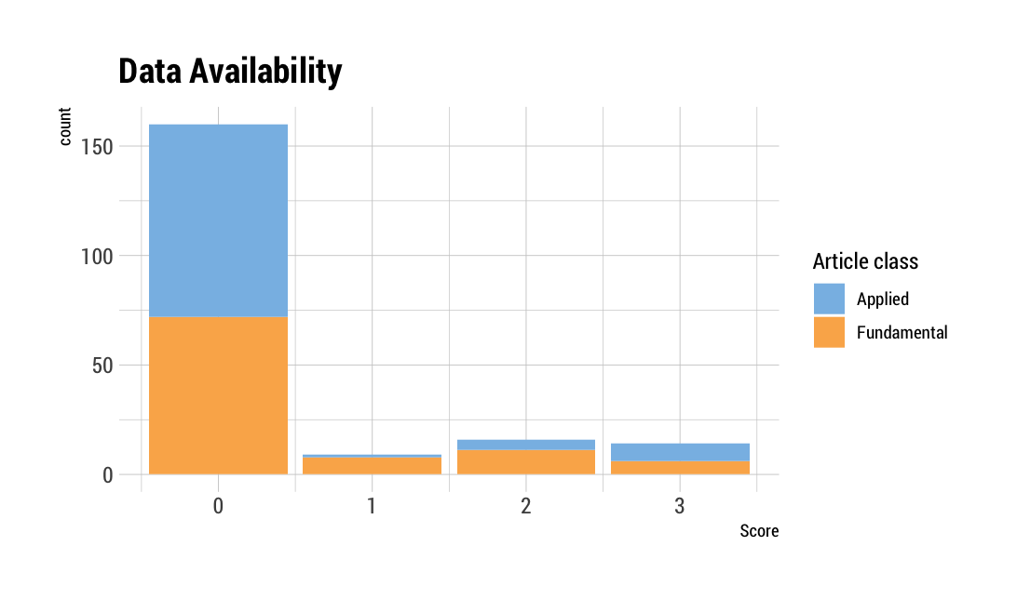
Data available?
0 - Not available
1 - Upon request to authors
2 - Online behind paywall
3 - Free access
n = 200
Sparks et al (unpublished)
Notes:
Reproducible research is still a new practice in plant pathology. Most data are not available in plant pathology publications.

Slide 3
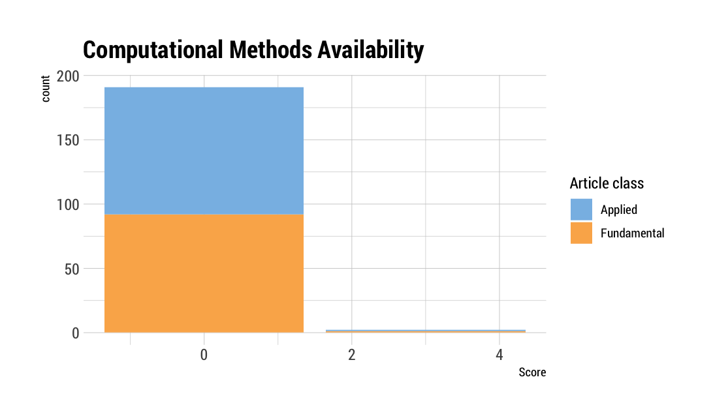
Code available?
0 - Not available
1 - Upon request to authors
2 - Online behind paywall
3 - Free archive
n = 200
Sparks et al (unpublished)
Notes:
Most computational methods are also not available in plant pathology in spite of using software that lends itself to this.

Slide 4
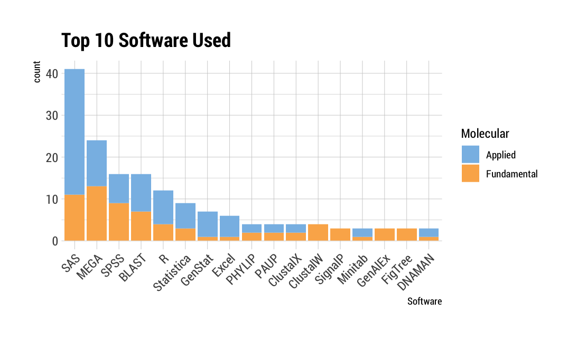
Software used?
n = 200
Sparks et al (unpublished)
Notes:
R is the third most commonly used software for statistical analysis behind SAS and SPSS, MEGA and BLAST are used for genetic work.

Slide 5


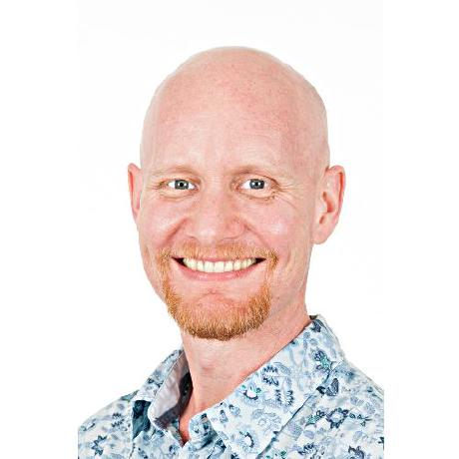

How can we change that?
www.openplantpathology.org
Notes:
How can we be the change in the world that we want to see? Start an initiative!

Slide 6
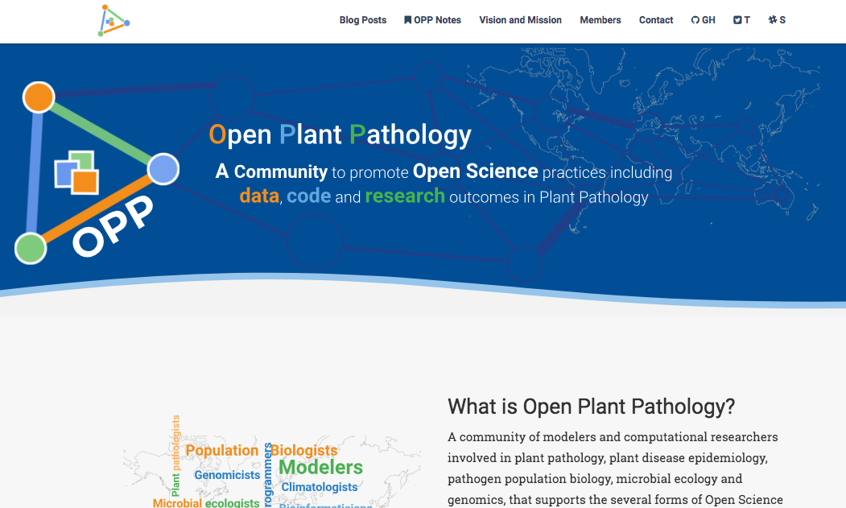






Website
Tools
rrtools
Notes:
We use several R tools plus Travis-CI to build and deploy our website. The site itself is build using Travis and deployed to Netlify automatically.

Slide 7
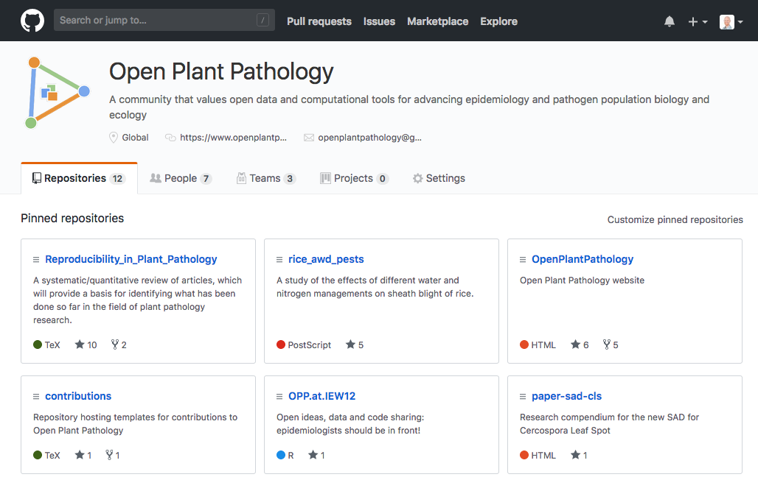
Collaborative coding: GitHub
Notes:
We use GitHub to:
Host repositories;
Share ideas, code and data;
Openly peer-review contributions (OPP notes)

Slide 8

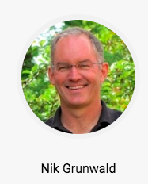
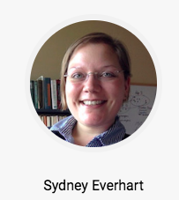
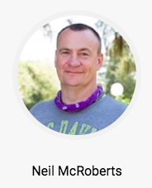
Outreach: workshops
Population Genomics in R
Introduction to R for Plant Pathologists
Introduction to Multivariate Statistics Using R
Notes:
Coming up in a few weeks in Boston, we will have workshops given by members of the OPP leadership team. Neil is in the process of putting his materials on the OPP GitHub and we will be linking this with our learning section

Slide 9

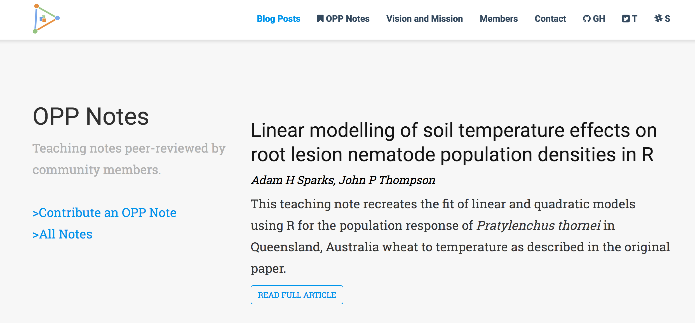
Where we’ve struggled
Notes:
Time! Most of us are academics.
Engagement in Slack started off great, but has tapered off since the start.
Only one note published so far. Limited interest in publishing a note by others so far, but some of us are planning to make our HDR students publish a note.

Slide 10

Where we’ve succeeded
Notes:
We currently have 398 followers
We’ve had >1500 views and positive responses on the note that we’ve published
Engagement and support, at the International Epidemiology Workshop last month in Norway, the group supported this initiative. Botanical epidemiologists have led the way in plant pathology for many years bringing new ideas and methods to the field and incorporating computational methods.

Slide 11
Citations
JJ Allaire, Yihui Xie, Jonathan McPherson, Javier Luraschi, Kevin Ushey, Aron Atkins, Hadley Wickham, Joe Cheng and Winston Chang (2018). rmarkdown: Dynamic Documents for R. R package version 1.10. https://CRAN.R-project.org/package=rmarkdown
Ben Marwick (2018). rrtools: Creates a reproducible research compendium. R package version 0.1.0. https://github.com/benmarwick/rrtools
RStudio Team (2016). RStudio: Integrated Development for R. RStudio, Inc., Boston, MA. http://www.rstudio.com/
Yihui Xie (2018). blogdown: Create Blogs and Websites with R Markdown. R package version 0.6.
Yihui Xie, Alison Presmanes Hill, and Amber Thomas (2017). blogdown: Creating Websites with R Markdown. Chapman and Hall/CRC. ISBN 978-0815363729
Hadley Wickham and Jay Hesselberth (2018). pkgdown: Make Static HTML Documentation for a Package. R package version 1.1.0. https://CRAN.R-project.org/package=pkgdown

Slide 12

Data and slide availability
Del Ponte, E.M. and Sparks, A.H. (2018). Compendium of R code and data for 'Open ideas, data and code sharing: epidemiologists should be in front!'. Accessed 04 Jul 2018. Online at https://doi.org/10.5281/zenodo.1304483
https://github.com/openplantpathology/OPP.at.IEW12
Sparks, A.H., Del Ponte, E.M., Everhart, S., Foster, Z.S.L., Grünwald, N., (2018). Compendium of R code and data for ‘Status and Best Practices for Reproducible Research In Plant Pathology’. Accessed 04 Jul 2018. Online at https://doi.org/10.5281/zenodo.1250665
https://openplantpathology.github.io/Reproducibility_in_Plant_Pathology
Sparks, A.H. and Del Ponte, E.M. (2018). Establishing a community for supporting and fostering adoption of reproducible research using R. Accessed 10 Jul 2018. Online at https://zenodo.org/badge/latestdoi/140354306
https://github.com/openplantpathology/OPP.at.useR-2018
Notes:
The graphs came from Del Ponte and Sparks 2018
The data for the graphs came from Sparks et al. unpublished

